Slide 1
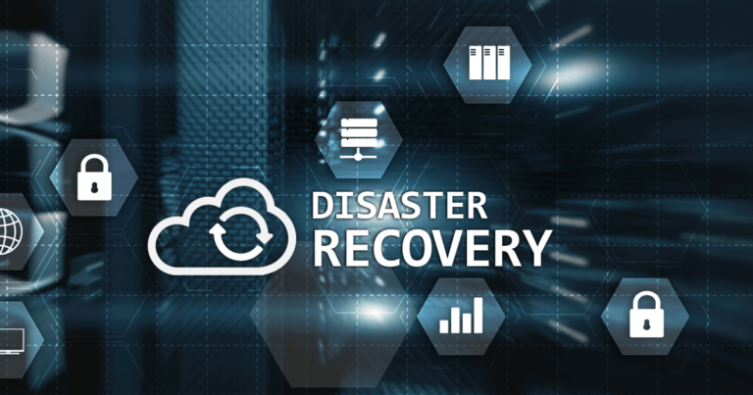

Disaster Recovery and Business Continuity Planning
VASAGIRI SRAVANI
192211045

Slide 2

Disaster Recovery and Business Continuity Planning
Disaster recovery (DR) and business continuity planning (BCP) are essential for ensuring business resilience in the face of disruptions.
Cloud computing offers unique opportunities and challenges for implementing effective DR and BCP strategies.

Slide 3

Key Considerations for Cloud DR and BCP Cloud Service Model The choice of IaaS, PaaS, or SaaS impacts DR and BCP strategies, as different services offer varying levels of control and flexibility. Data Security and Compliance Ensuring data confidentiality, integrity, and availability is critical, especially in regulated industries.
Recovery Time Objectives (RTOs) and Recovery Point Objectives (RPOs) RTOs and RPOs define acceptable downtime and data loss, influencing DR and BCP strategies.
Cloud Provider Service Level Agreements (SLAs) SLAs outline cloud provider responsibilities for uptime, performance, and disaster recovery capabilities.

Slide 4

Understanding Cloud-Based DR and BCP
Cloud-Based Redundancy
Cloud providers offer multiple data centers in different geographic locations, providing inherent redundancy and disaster tolerance.
Automated Failover
Cloud platforms can automatically fail over workloads to a redundant infrastructure in the event of a disaster.
Data Backup and Recovery
Cloud providers offer robust data backup and recovery solutions, ensuring rapid restoration of critical data.

Slide 5
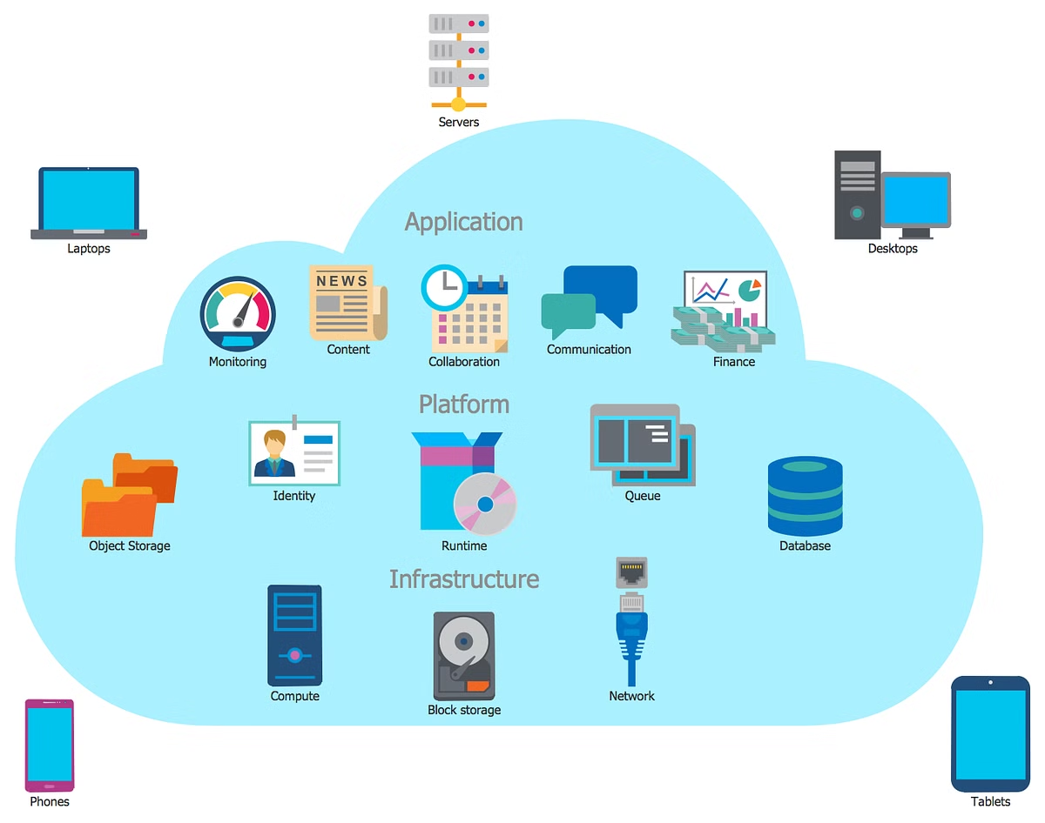
Disaster Recovery and Business Continuity Planning in Different Cloud Models
IaaS
In Infrastructure as a Service (IaaS), businesses are responsible for managing their own operating systems, applications, and data. They need to implement their own disaster recovery strategies, using cloud services as a platform.
PaaS
Platform as a Service (PaaS) providers offer a platform for developing and deploying applications. Disaster recovery plans should leverage PaaS features for automatic backups, replication, and failover.
SaaS
Software as a Service (SaaS) providers manage all aspects of the application, including disaster recovery. Businesses need to understand their SaaS providers' disaster recovery capabilities and include them in their planning

Slide 6
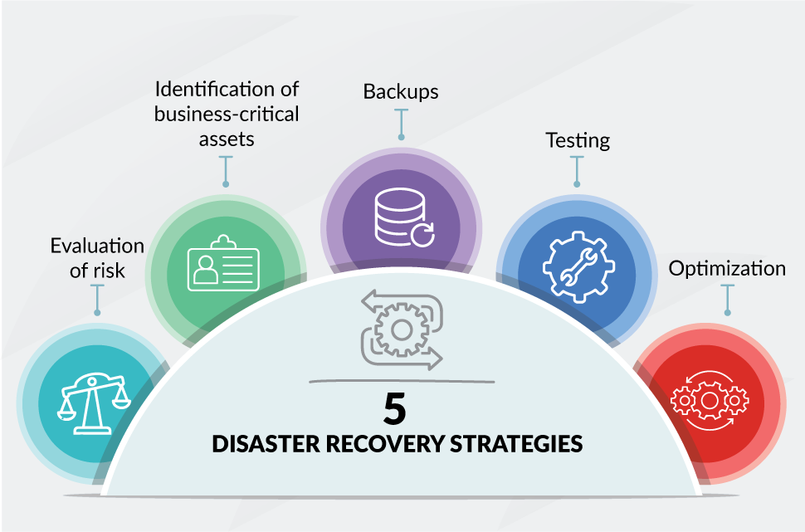
Designing a Comprehensive Cloud DR and BCP Strategy
Designing a Comprehensive Cloud DR and BCP Strategy
Risk Assessment
Identify potential threats and vulnerabilities that could disrupt business operations.
Business Impact Analysis
Assess the impact of disruptions on critical business functions and prioritize recovery efforts.
Develop DR and BCP Plans
Document detailed plans for recovery procedures, including roles, responsibilities, and communication protocols.
Test and Review
Regularly test DR and BCP plans to ensure their effectiveness and identify areas for improvement.

Slide 7
Best Practices for Successful Cloud DR and BCP
Best Practices for Successful Cloud DR and BCP
Regular Testing and Training
Test DR and BCP plans at least annually to ensure their effectiveness.
Strong Communication Plan
Establish clear communication channels and protocols to ensure timely and accurate information flow during a disaster.
Ongoing Monitoring and Evaluation
Continuously monitor cloud services and infrastructure to identify potential vulnerabilities and update DR and BCP plans as needed.
Collaboration with Cloud Provider
Maintain open communication and collaboration with your cloud provider to

Slide 8
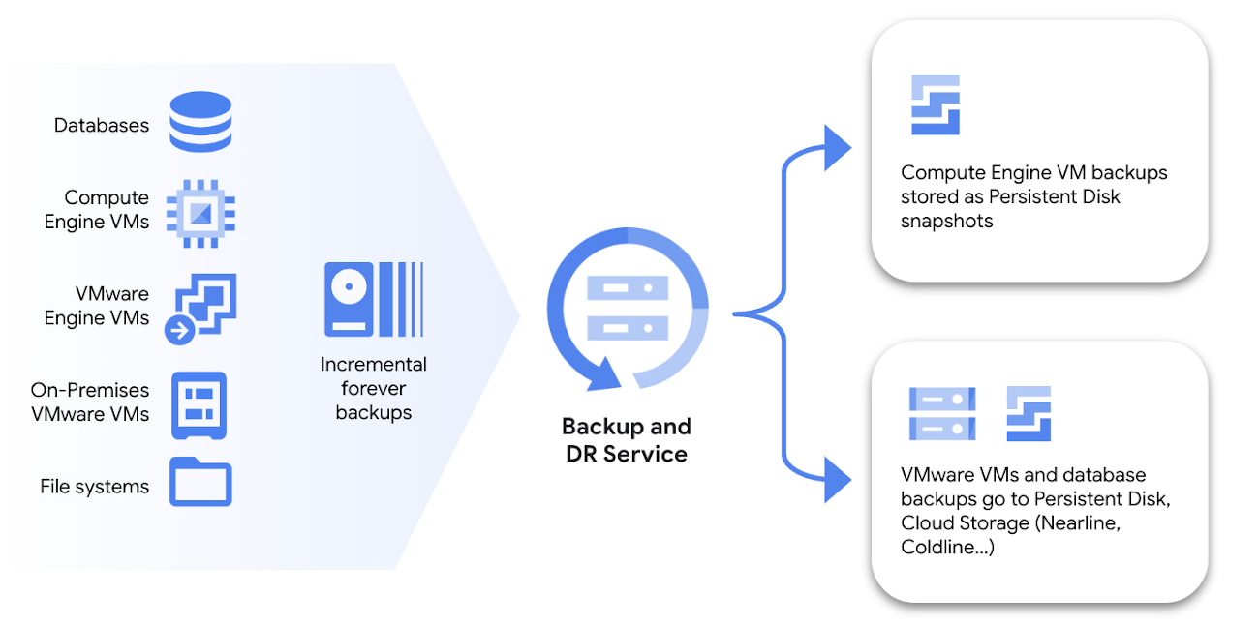
Designing a Comprehensive Cloud DR and BCP Strategy
Google Introduces Cloud Backup and Disaster Recovery
BUY 2 GET 1 FREE!!!
$23.98 $47.96
Product Code: 16765358
Stock In Stock
Attributes

Slide 9
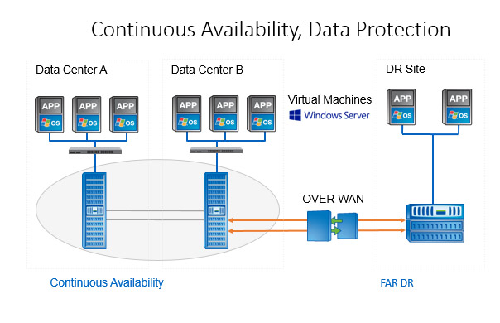
Cloud DR and BCP Solutions Data Replication and Backup Cloud providers offer solutions for replicating and backing up data across multiple data
Disaster Recovery as a Service (Dr aa S)
(Dra a S} providers offer managed DR services, including infrastructure, software, and expertise.
Business Continuity as a Service (B ca a S)
(BC aa S) providers offer comprehensive solutions for business continuity, including disaster recovery, data protection, and business process continuity.

Slide 10
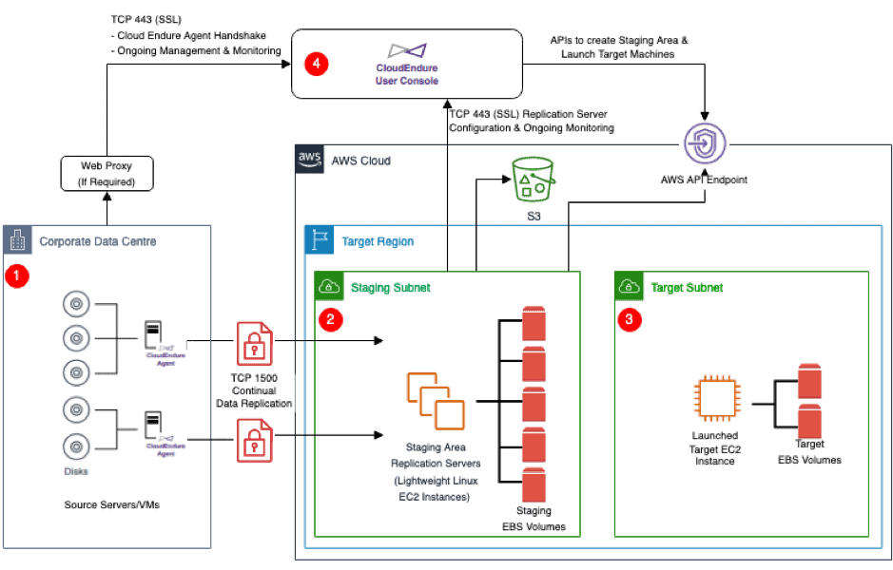
Implementing Cloud DR and BCP Strategies Choose a Cloud Provider
Insteps:
1.Choose a Cloud Provider
Select a cloud provider with robust DR and BCP capabilities and a strong track record of reliability.
2.Design and Configure DR and BCP Solutions
Implement data replication, backup, and recovery solutions based on your specific requirements.
3.Test and Validate
Perform regular tests and simulations to ensure the effectiveness of DR and BCP plans.
4.Document and Communicate
Document all DR and BCP plans, procedures, and contact information for relevant personnel.

Slide 11
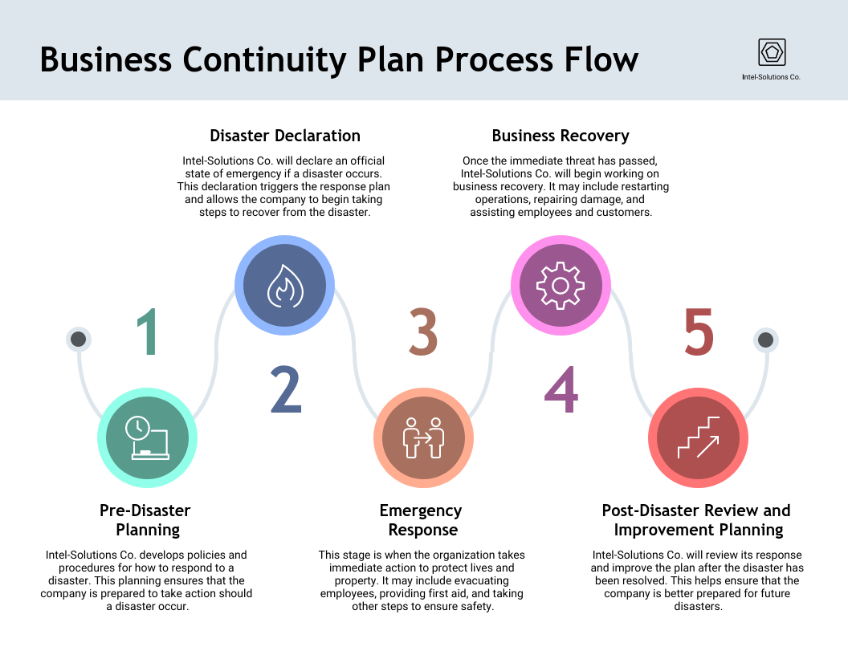
Benefits of Cloud-Based DR and BCP
Benefits of Cloud-Based DR and BCP
Enhanced Security
Cloud providers invest heavily in security infrastructure and best practices.
Reduced Recovery Time
Automated failover and cloud-based recovery solutions minimize downtime.
Cost Optimization
Cloud-based DR and BCP solutions can be more cost-effective than traditional on-premises solutions.
Scalability and Flexibility
Cloud resources can be easily scaled up or down based on business needs.

Slide 12
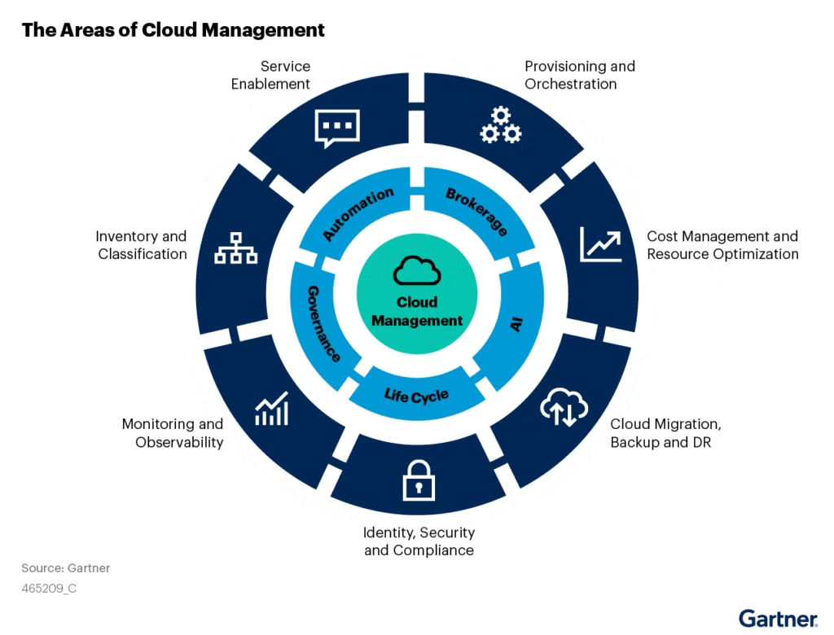
The Role of Automation
Automated Backup and Recovery
Automate data backups and recovery processes to ensure that backups are taken regularly and that data can be recovered quickly in the event of a disaster. Cloud providers often offer automation tools.
Real-Time Monitoring
Use real-time monitoring tools to identify potential issues early on. This allows for proactive intervention and reduces the likelihood of a major outage.
Data Analytics
Utilize data analytics to identify patterns and trends that can help predict potential disasters. This allows businesses to take preventive measures and minimize the impact of disruptions.

Slide 13
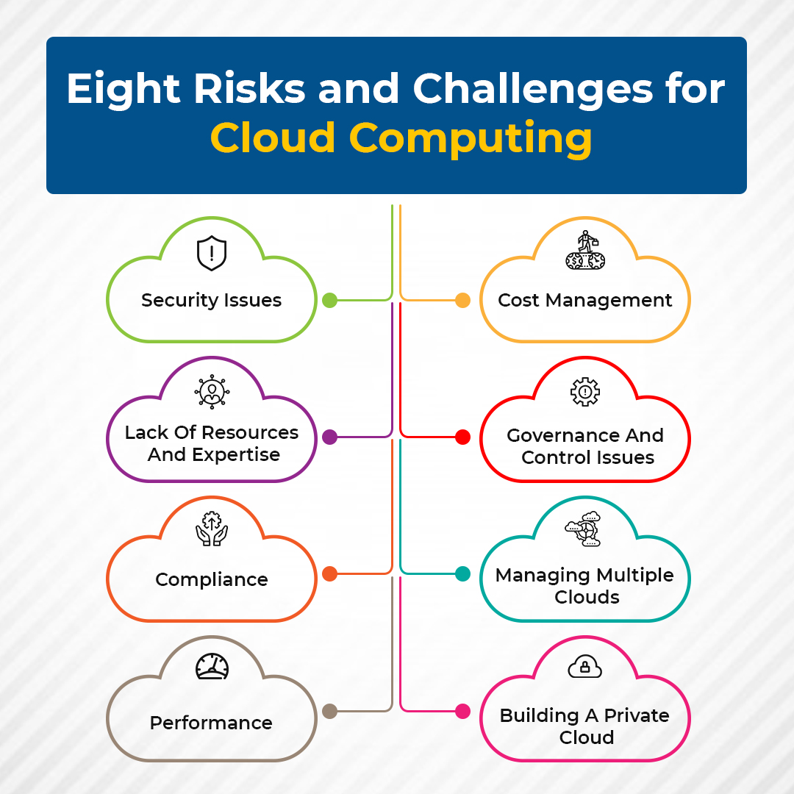
Challenges of Cloud-Based DR and BCP
Cloud Provider Dependencies
Reliance on cloud providers for critical DR and BCP functions.
Data Sovereignty
Ensuring compliance with data residency regulations across different cloud regions.
Complexity of Cloud Environments
Managing DR and BCP in complex, multi-cloud environments.

Slide 14

The Future of Disaster Recovery and Business Continuity Planning
The future of disaster recovery and business continuity planning is likely to be driven by advancements in cloud computing, artificial intelligence, and machine learning.
These technologies will enable businesses to automate disaster recovery processes, improve data security, and make more informed decisions.

Slide 15

Conclusion
Disaster recovery and business continuity planning are essential for businesses relying on cloud computing. These plans help minimize the impact of disasters, ensuring business continuity and data protection. By implementing best practices, embracing automation, and staying informed about emerging technologies, businesses can navigate the challenges of disaster recovery in the cloud and maintain their resilience.

Slide 16

THANK YOU

